Slide 1
2025

Slide 2
Agenda
9:50
Welcome & intro
13:45
Keynote - How to engage in a disengaged workplace (winning hearts and minds)
10:10
Data, trends and innovations for healthcare in 2025
14:10
Panel - Beyond the Hype: Practical successes with AI, analytics and digital tech
10:30
Panel - Femtech in Corporate Wellbeing: Enhancing Women’s Health in the Workplace
14:50
Break and breakout session (GREEN group)
11:15
Break & breakout session (BLUE group)
15:35
British Paralympic Association
12:00
Round Table Discussion: Data for measurement & ROI
16:05
Speed roundtable:
Key takeaways and actions
12:45
Lunch & breakout session (RED group)
16:20
Closing remarks
16:30
Drinks reception

Slide 3
2025
Jo Paice Clinics & Specialist Care Director, Bupa
Chris Cummings
CEO
Wellbeing at Work
Notes:
Hello and welcome
Great to see so many familiar faces and some new ones too.
It’s been an exciting year since we last got together in many ways (and not only for Bupa). Some of that excitement has even been good.
For me the most exciting bit was that 2024 was the year when Bupa’s Connected Care Strategy really started turbo-charging.
(Move to first slide)

Slide 4



ConnectedCare:
Joined up healthcare for better outcomes
We are better connecting health insurance with our digital healthcare platform Blua, our network of health clinics and the Cromwell Hospital to make healthcare more convenient, cost effective with deliver
better outcomes.
01.
02.
03.
More
convenient
Fast and guaranteed access to treatment
that's included
as standard
Delivering better
clinical outcomes
You’ll receive the best
possible care, in the
right place, at the
right time
More
cost-effective
A focus on prevention
and optimising care
pathways to help manage healthcare costs
Notes:
As you may know, Bupa has now completely in-sourced all the virtual GP appointments that we offer our insurance customers
The insight that we have gained from this has allowed us to think harder and deeper about where we next want to support our customers.
When we combine this with the data that comes out of our health assessments, to see underlying health trends this becomes really powerful.
We can then build out the right services and pathways to deliver the benefits of Connected Care to all our customers, whether they are insured or otherwise.
And this is strategy is now being executed as we speak
(Move to next slide)

Slide 5





We are growing our provision footprint and services in key areas of customer need, delivering better access and improving outcomes
Through London Medical, we’re investing and innovating in diabetes & obesity care, improving screening and primary care, adding further diagnostic capabilities and providing onward pathways to complex surgical care.
2023
2025
1 site
1 site
1 site
2 sites
Our network of soon to be 8 specialist dermatology clinics enable us to expand much needed dermatology diagnostics and treatment for insured and selfpay customers
59 sites
76 sites
Our retail partnerships with Boots & Tesco have the potential to expand our primary care services countrywide, bringing face to face Bupa GP to the high street.
Notes:
Diabetes, pre-diabetes and metabolic syndrome are significant issues in society and are reflected in the data from our health assessments.
management of diabetes an area that requires increased focus and growth
really pleased to have acquired the London Diabetes Centre as part of our acquisition of London Medical earlier this year.
early results from our Weight Management programmes show that customers on our plan lost an average of 11% BMI in the first 20 weeks and those who participated in our health coaching programmes as part of the weight management plan lost 12.9% of their BMI.
These are really significant changes that can have huge impact on peoples lives and their healthspan.
Medicalised weight-loss is not appropriate for everyone but it can have a real impact on those who otherwise struggle to manage their chronic condition.
Dermatology continues to be one of the top 3 referring conditions, both from GP appointments and health assessments alike.
Telederm continues to make huge strides forward but we still see the need for the skin condition to be assessed in person by either a GP or dermatologist.
Integrating The Dermatology Partnership into our business, through their standalone clinics or by introducing dermatology into our existing clinics or onsite footprint where appropriate.
We know how much mental health remains a massive priority for everyone. It’s an area that is growing substantially in need.
Really proud of the mental health services we provide to our insured customers; which give customers access to treatment within 10 days and we are delighted to have extended our services to cover children and young people recently.
60% customers prefer to have a face to face appointment initially
Intend to launch our face to face service this year and have plans to build out a network of specialist mental health clinics that will be available to both insured and non-insured customers alike.
(Move to next slide)

Slide 6




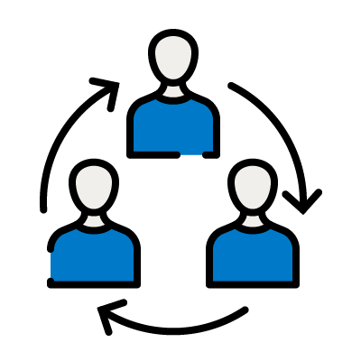


ConnectedCare
brings together our app,
Bupa clinicians and partnerships with independent providers
One app for healthcare with My Bupa
Our unique healthcare app delivers joined up healthcare
providing access to clinicians, automated pre-authorisation
and convenient booking for Bupa Platinum Consultants
and more.
Integrated pathways
and specialist services
Specialist pathways with Bupa Clinics & Cromwell Hospital for mental health, MSK and cancer optimise treatment
for speed, convenience and outcomes.
Clinical services
Over 1,500 doctors, health advisors and clinicians, 70 health clinics, 360 dental practices and 1 full service hospital who can deliver unique seamless healthcare services for our insurance customers
Winner of Outstanding group healthcare provider
Independent healthcare partners
National network of healthcare providers, including our Bupa Platinum Consultants and Specialist Cancer Centres who collaborate with us to deliver the best possible experience for members
Notes:
In order to continue to grow our Connected Care strategy, we know that our services need to be as accessible as possible for our customers so that they choose Bupa provision.
We continue to invest in consolidating our services in the MyBupa app and improving the accessibility and experience of that app.
We continue to grow our network of Clinics to enhance accessibility for customers and look to add more services in our locations, such as the introduction of mammography services into a further four clinics over recent weeks. In addition, we are exploring new ways of becoming accessible to our customers with GP-only clinics in two Boots stores and other services in Tesco.
Our Be.Well@Work proposition is also evolving so that we are able to deliver more services to our corporate customers in their offices, as well as expanding the number of onsite clinics that we have so that health can be at the heart of the company’s experience.
We believe that healthcare thrives by empowering people to understand their own health better so that they can be aware when changes occur. This might be through advanced technologies such as genomics or it might be through the simple fact of understanding your own normal. Once a customer understands what is normal for them, that’s when future health plans become truly personalised.
(Move to next slide)

Slide 7


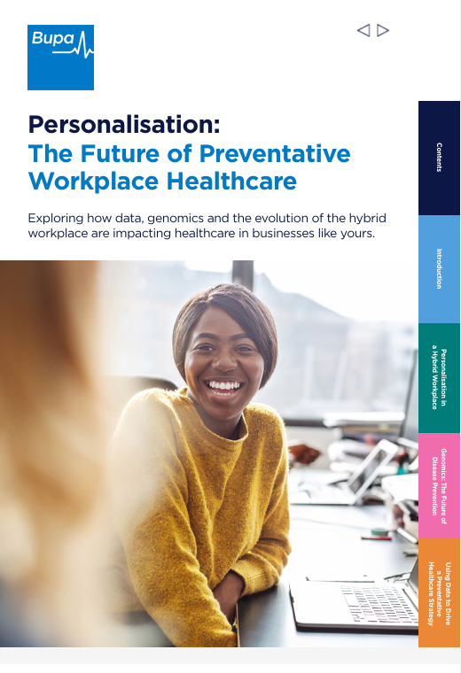
eBook
Personalisation:
The Future of Preventative Workplace Healthcare
Latest trends and initiatives by leading organisations.
Harnessing data for a personalised workplace strategy.
Personalised, preventative healthcare in a hybrid work environment.
Genomic sequencing and the future of preventative healthcare.
Notes:
We've brought together insights from experts on the future and current state of personalised, preventative healthcare, covering:
Latest trends and initiatives
Data for a personalised strategy.
Hybrid work environments
Genomic sequencing
(Move to next slide)

Slide 8

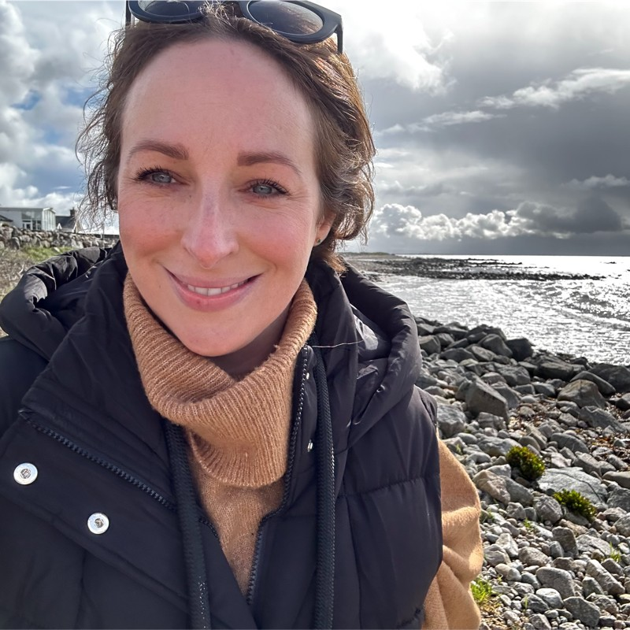


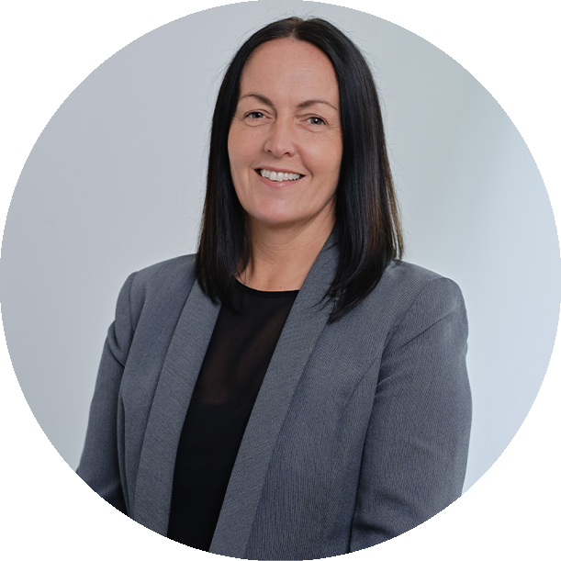
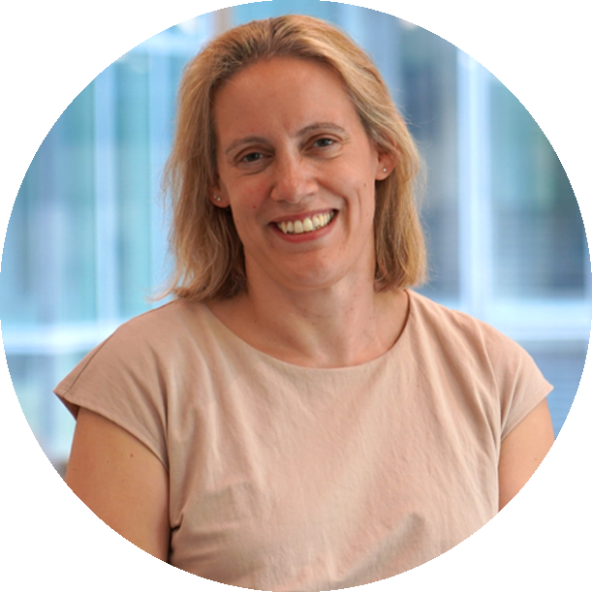

Virtual Masterclass
How to Make Workplace Healthcare Preventative & Personalised
12pm GMT, March 18th
Real life case studies to apply to your business from:
Lisa Aslam,
Principal Benefits Manager EMEA, Workday
Alice Bradley,
Head of People, Bupa
Emily Jones,
Client Consulting Director, Broadstone
Hosted by Jo Paice,
Clinics & Specialist Care Director, Bupa
Notes:
We’ll also be running a masterclass, with practical insights and real life case studies from inside workplaces, directly from the people implementing them - make sure to join us on March 18th at 12pm!
We'll be following up after the event for you to access the eBook and register for the masterclass, so please keep an eye out for the email!
Today’s agenda is packed full of some of the topics closest to our heart; whether it’s looking at the current landscape of innovation, women’s health, mental health, how we use data and technology to the best of our ability and how we can continue to strive to make healthcare more inclusive.
We have a fantastic line up of panellists and speakers and I am really looking forward to hearing them all. I’d like to give a huge thank you to everyone involved in the event and speaking.
I hope you have an enjoyable and enlightening day and I’m looking forward to catching up with or meeting as many people as possible during the networking breaks.
Thank you.

Slide 9
2025

Slide 10
Data, trends and innovations for healthcare in 2025
Dr Rishi Patel
Head of Health Services Proposition, Bupa

Slide 11


The power of data in healthcare
30% of the world’s data is generated by the healthcare industry. RBC Capital Markets.
35% of individuals (UK) currently own
and use a wearable device. Statista, 2024.
•
64% of general public happy for health data collected to be shared with their doctor so they can help make healthy lifestyle choices.
The Health Foundation, 2024.
97% of data generated by the healthcare sector goes unused. World Economic Forum, 2024.

Slide 12

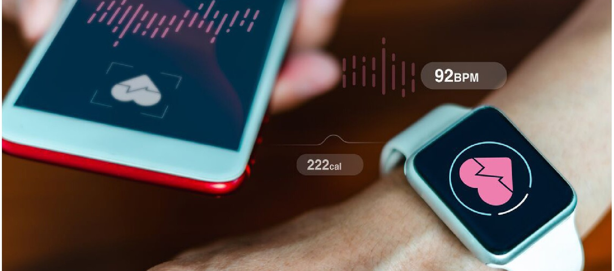
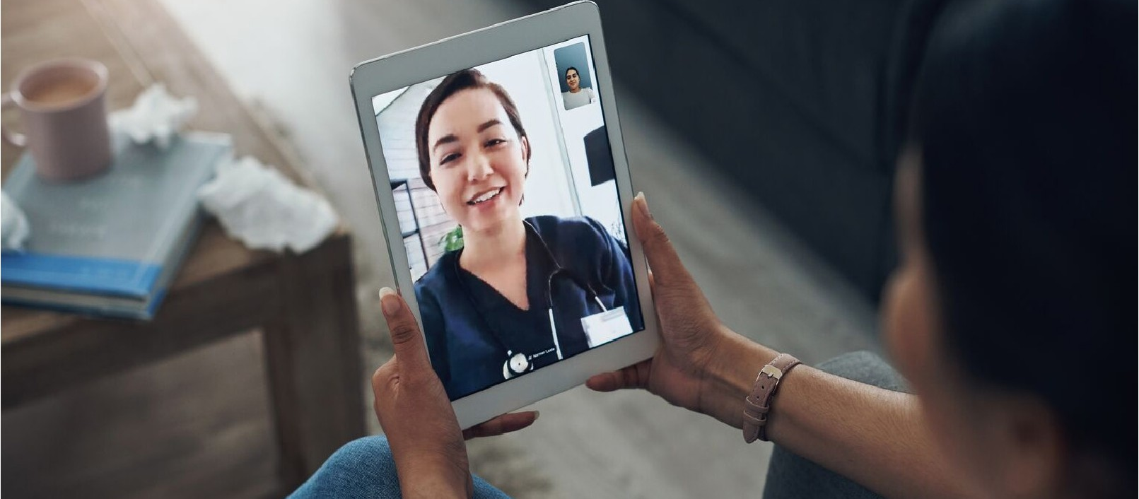
Trend 1 - Digital Transformation
Over 50% of patients use apps to manage their health conditions and access healthcare service.
NHS, 2023.

Slide 13
Trend 2 -Preventative
Care and Wellness Programmes
63% of people report taking proactive steps to improve their health, such as regular health
check-ups and lifestyle changes.
Bupa's Wellbeing Index, 2022.

Slide 14
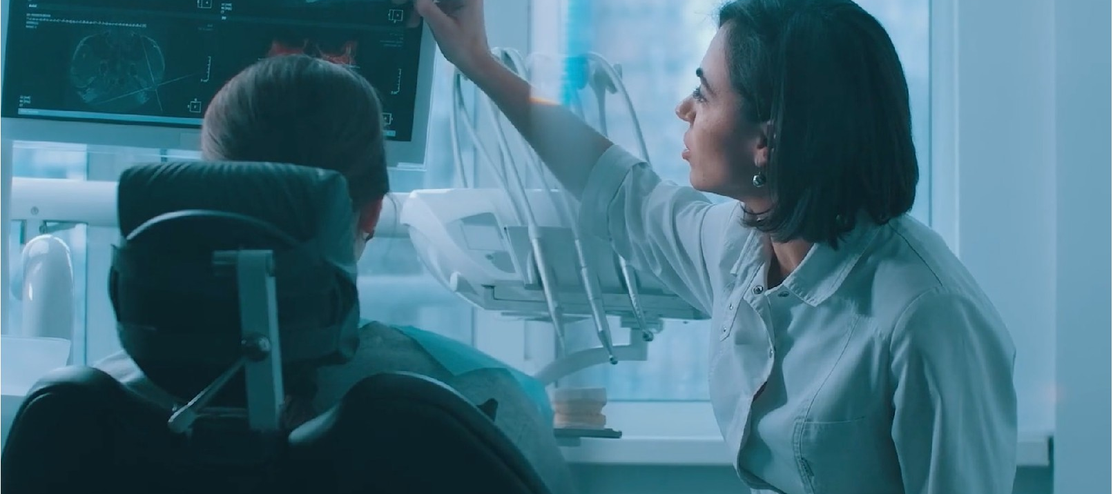

Trend 3 - Personalised healthcare
More than 70% of individuals report intent take preventative actions based on their genomic risk scores.
MassMutual, 2024.

Slide 15
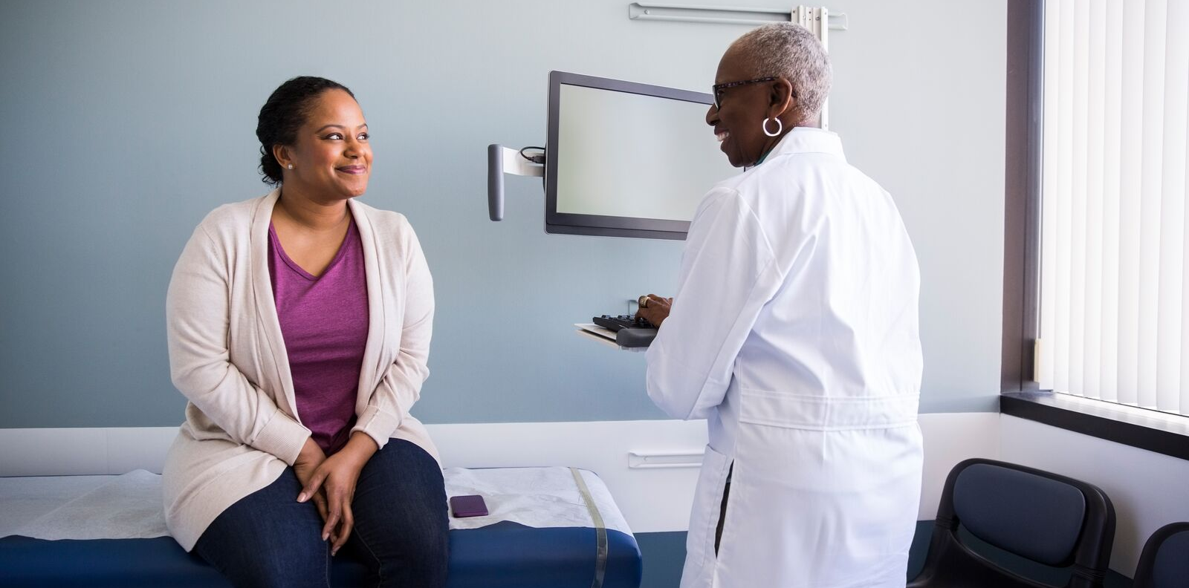

UK clinicians spend up to
13.5 hours / week
documenting clinical notes
Nuance MediaRoom, 2022.
AI – ambient
listening

Slide 16
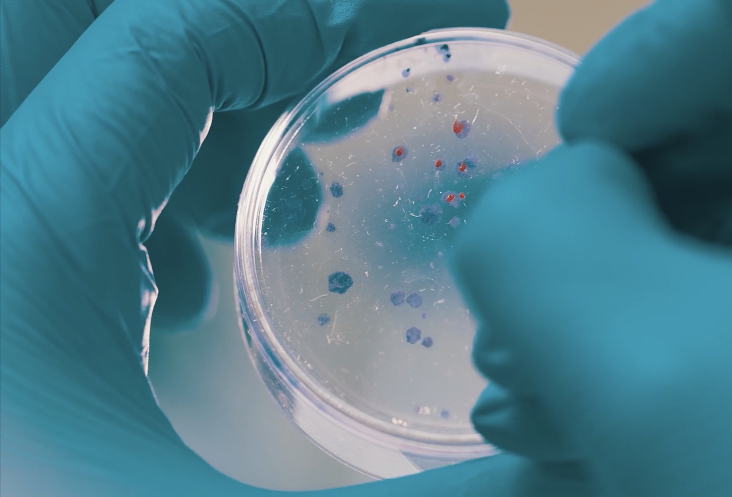


Genomics
•

Slide 17
2025

Slide 18
Please welcome your Innovate 2025 panel:
Sarah Bottomley
Marketing and Product Director, Bupa (Chair)
Janet Lindsay
CEO, Wellbeing of Women
Claire Sharman
Benefits Strategy Consultant, Mercer Marsh Benefits
Valentina Milanova
Founder and CEO / CPO, Daye
Lauren Lunniss
Health & Wellbeing Manager, BNP Paribas

Slide 19
Break & breakout session (BLUE group)

Slide 20

2025
Brave
Make new possibilities happen

Slide 21

2025
Roundtable discussion
Duncan Jones
Head of Strategic Relationships, Bupa

Slide 22
Slido
Why does your organisation or your corporate client collect wellbeing data?

Slide 23
1.
2025
Which data points do you use to measure and analyse wellbeing and ROI within yours or your client’s organisation?

Slide 24
2.
2025
How do you or your client gather, analyse and take action on that data?

Slide 25
Lunch & breakout session (RED group)

Slide 26
2025
Caring
Act with empathy and respect

Slide 27
How to engage in a disengaged workplace (winning hearts and minds)
Ryan Hopkins
Chief Impact Officer, JAAQ

Slide 28
2025

Slide 29
Please welcome your Innovate 2025 panel:
Joe Fairbrother
IT Director, Bupa Clinics (Chair)
Dr Umang
Patel
Chief Clinical Information
Officer, Microsoft
Dr Salil Patel
Computational Neuroscientist, Oxford. Radiologist, Guy’s and St Thomas' Hospital.
Chuxx Onyia
Health & Performance Lead EMEA,
Google
Elizabeth Hampson
Life Sciences and Health Innovation Partner, Deloitte

Slide 30
Break & breakout session
(GREEN group)

Slide 31
2025
Responsible
Own your decisions and actions

Slide 32


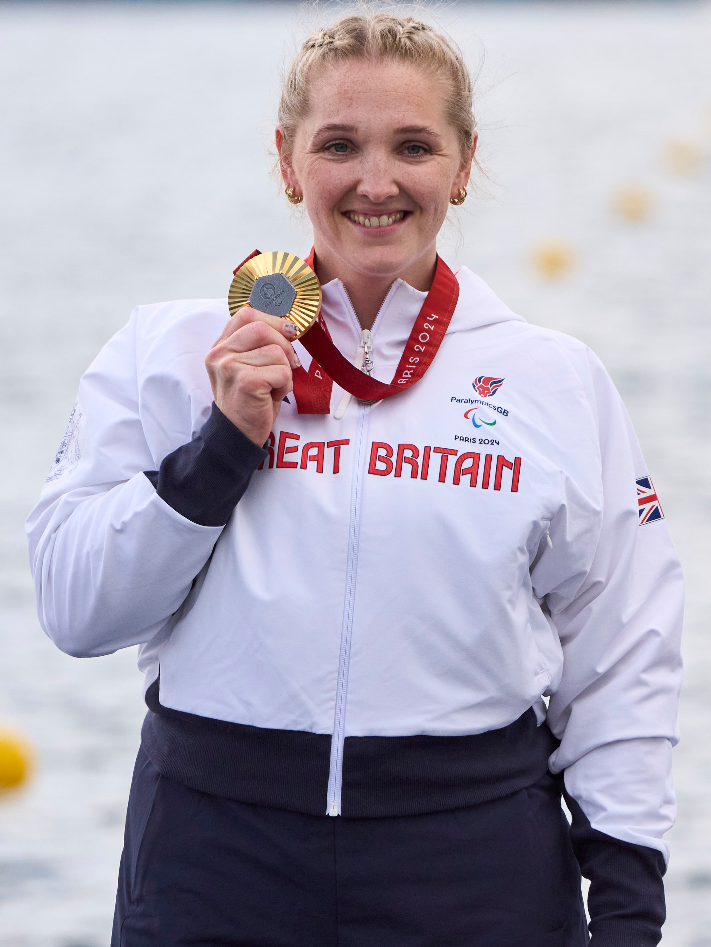

British Paralympic Association
Charlotte Henshaw, BPA
Anna Russell,
Director of CRS & Bupa Foundation, Bupa (Host)

Slide 33
2025

Slide 34
2025
Speed roundtable:
Key takeaways and actions
Duncan Jones
Head of Strategic Relationships, Bupa

Slide 35

2025
Thank you
What’s next?
Masterclass
Personalised preventative care ebook
Webinar and more exciting content

Slide 36
Drinks reception

